Slide 1
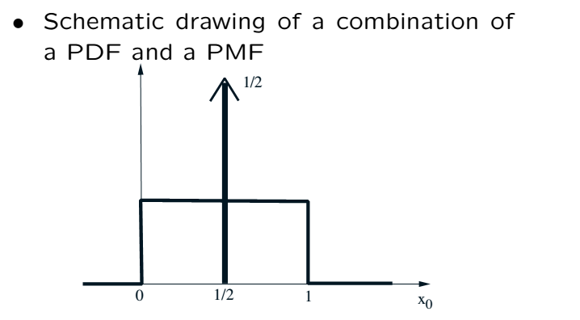

Mixed Distributions
Dirac’s delta function shows that

Slide 2
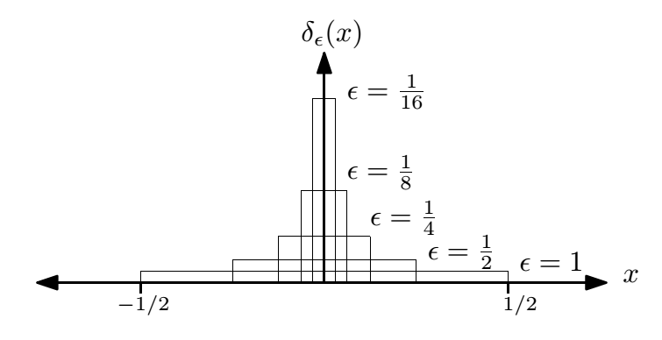

Recalling Dirac’s Delta

Slide 3
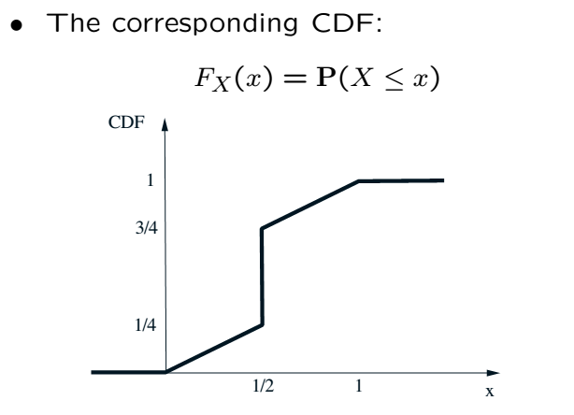
Mixed Distributions Cont’

Slide 4
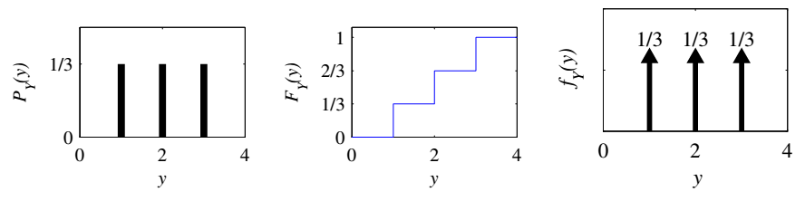
Example of Mixed Distributions

Slide 5
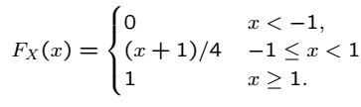
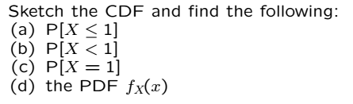
Worked Example

Slide 6
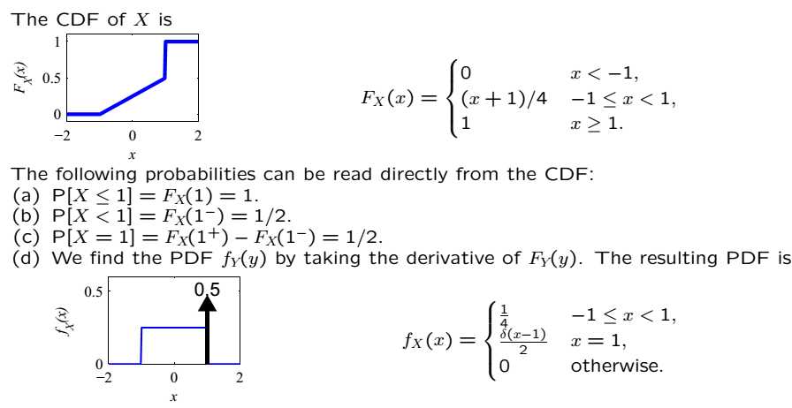
Solution

Slide 7
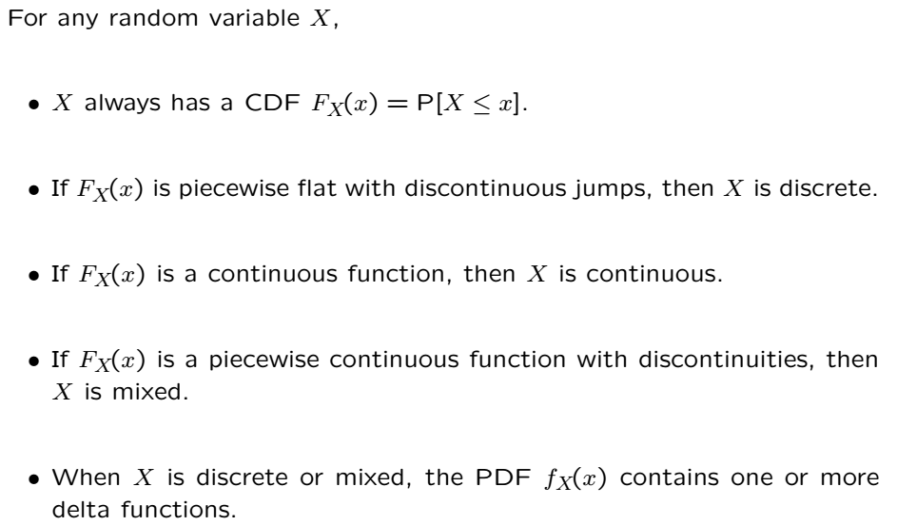
Continuous vs Discrete vs Mixed RVs

Slide 8
Acknowledgements and Citations
Parts of these slides are adapted from the following resources:
Power Point Lecture Slides for the Textbook http://bcs.wiley.com/hebcs/Books?action=index&bcsId=8676&itemId=1118324560
John Tsitsiklis. 6.041 Probabilistic Systems Analysis and Applied Probability, Fall 2010. (Massachusetts Institute of Technology: MIT OpenCourseWare),http://ocw.mit.edu (Accessed 13 Apr, 2015). License: Creative Commons BY-NC-SA

